Slide 1

Mindful Moments: Your Path to Inner Peace
Discover Mindful Moments, an app designed for your mindfulness journey. Features include a responsive meditation timer, ambient sounds, guided sessions, and secure Firebase email login.

Slide 2

The Science of Mindfulness
Stress Reduction
Mindfulness cuts stress hormones by 43%
Improved Focus
Boosts attention by 25%, per Psychological Science study
Emotional Regulation
Harvard research shows better control of emotions
Better Sleep
Promotes quality sleep, JAMA findings confirm

Slide 3
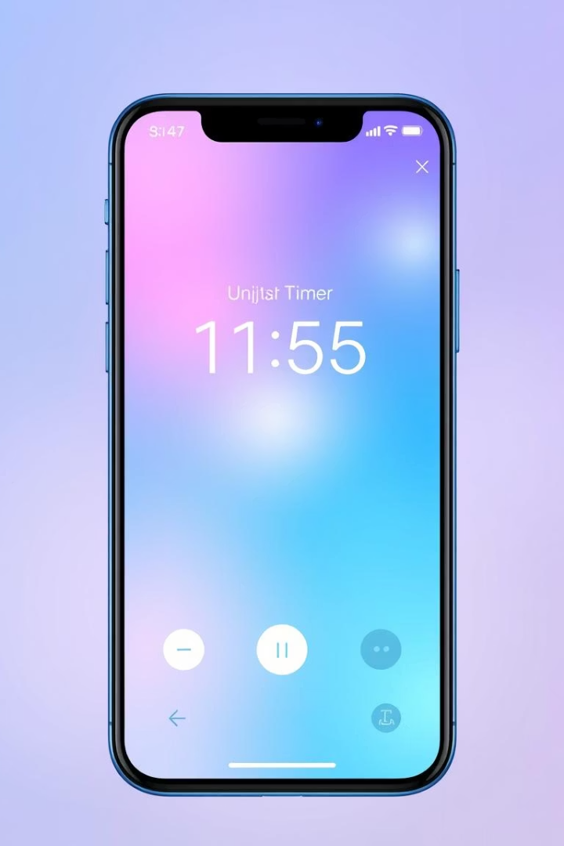
Core Features: Responsive Meditation Timer
Customizable Duration
Set any time you prefer or choose presets
Gentle Chimes
Start and end with soothing sounds
Visual Progress
Track your session with intuitive progress visuals
History Tracking
View and reflect on past sessions with timestamps

Slide 4
Immersive Ambient Soundscapes
Curated Sounds
Custom Mixing
High-quality ambient nature and music sounds
Create your ideal soundscape
Rain, forest, ocean, birdsong
Mix different sounds seamlessly
Instrumental, binaural beats, white noise
Adjust volume for each element

Slide 5




Guided Meditation Sessions
All Levels
Session Variety
Guidance tailored for beginners to advanced
1
Focused on stress relief, sleep, gratitude, and more
2
Fresh Content
4
Expert Voices
Weekly updates driven by user feedback
3
Soothing audio guidance from mindfulness experts

Slide 6
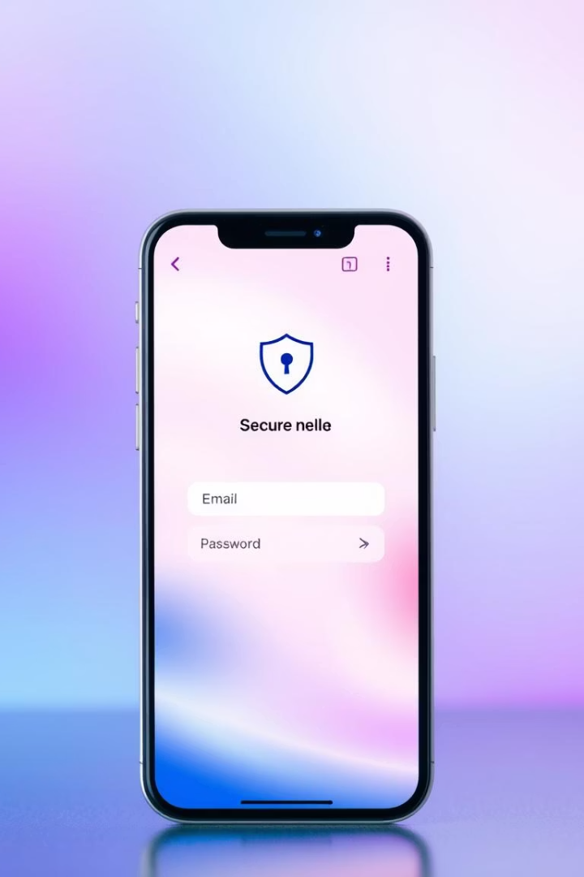
Firebase Authentication: Secure & Personalized
Email/Password Login
Simple, secure access to your account
Personalized Profiles
Track progress and tailor preferences
Cloud Sync
Backup meditation history across devices
Data Privacy
Fully GDPR compliant protection of your data

Slide 7
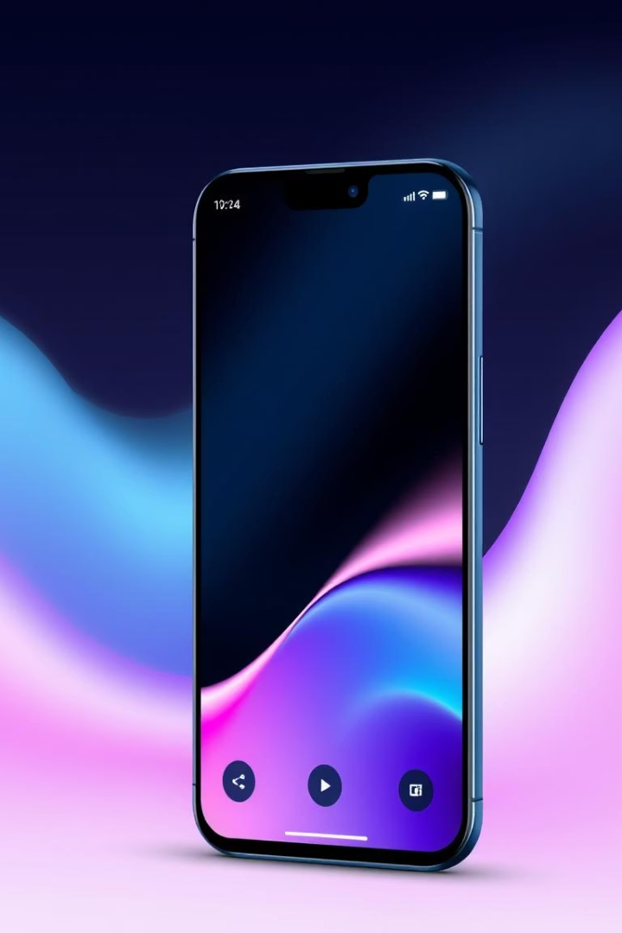
User Interface and Experience
Sleek Design
Easy navigation with clean layout
Dark Mode
Comfortable nighttime meditation
Custom Themes
Personalize colors and styles
Accessibility
Designed for all users, including those with disabilities

Slide 8
Start Your Journey to Mindfulness Today
Download Now
Free Trial
Premium Subscription
Launch Offer
Available on iOS and Android
Explore limited features with no cost
Enjoy 20% off your first annual subscription
Unlock full features and exclusive content

